Slide 1
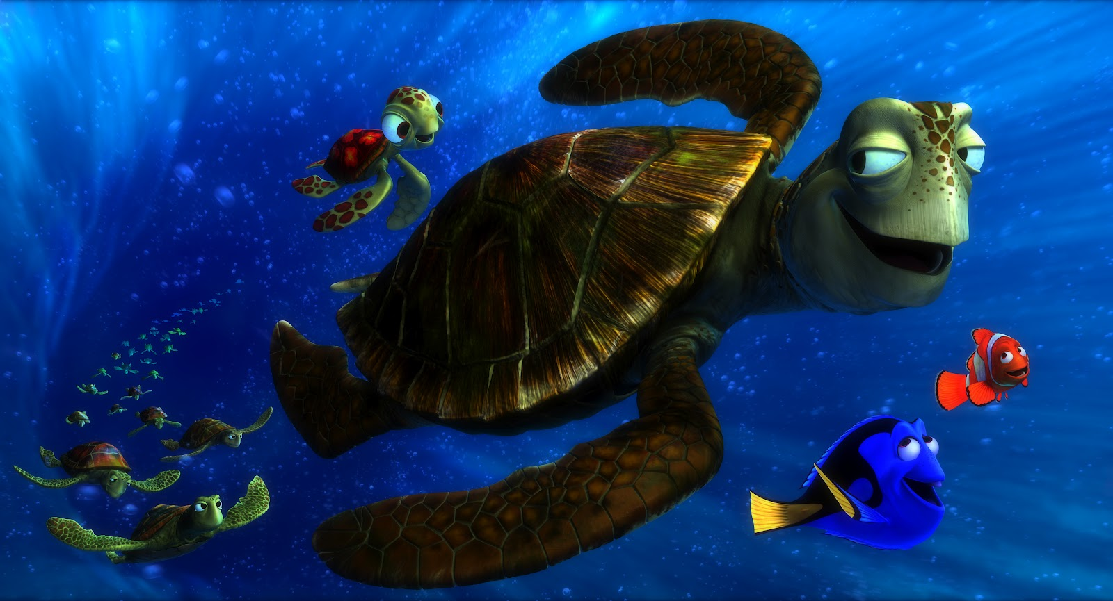
CURRENTLY OCEAN CURRENTS!
TARGET: After 42 minutes I can…
Identify specific ocean currents and their general temperatures.

Slide 2
PHENOMENA: In 1992, a cargo ship carrying bath toys got caught in a storm. Shipping containers washed overboard, and the waves swept 28,000 rubber ducks and other toys into the North Pacific. But they didn't stick together -- the ducks have since washed up all over the world. How did this happen?

Slide 3
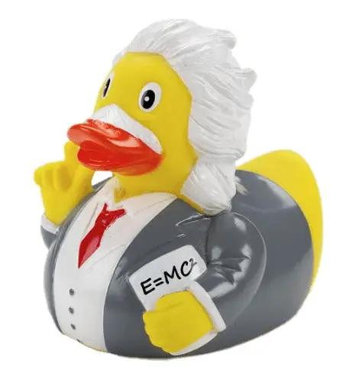
BRAINSTORM

Slide 4
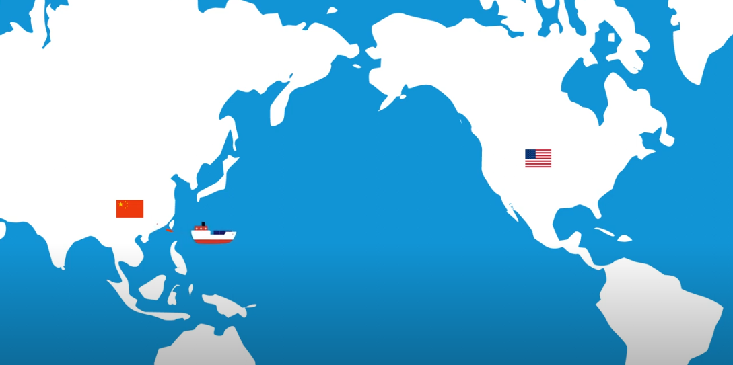
When Thousands of Rubber Ducks Were Accidentally Dumped into the Ocean (youtube.com) 50 secs The epic journey of the plastic ducks – YouTube 3 mins

Slide 5
DEFINE OCEAN CURRENT:
Describes the MOTION of the Ocean

Slide 6
What are the 3 factors that drive Ocean Currents?
Wind
Density Differences
Tides

Slide 7
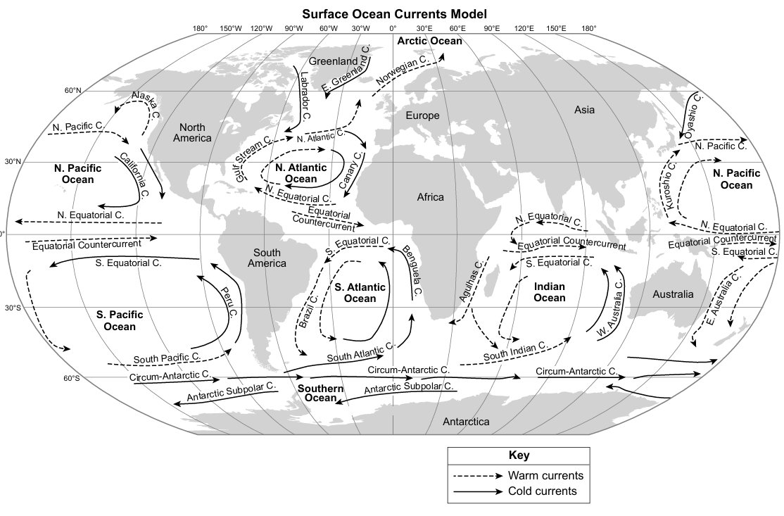
Where can we find the
Surface Ocean currents MODEL in the esrt?
PAGE 20

Slide 8




What are the
2 MAIN TYPES of
Ocean Currents?

Slide 9
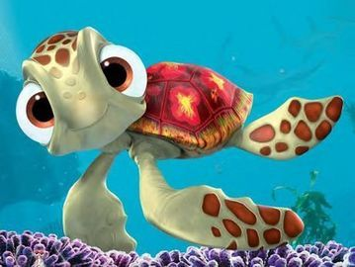
PART 1: Ocean Current TRENDS

Slide 10
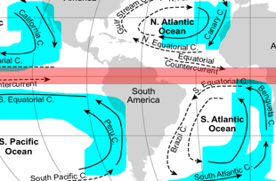











Circle your answers:
Q1. Most of the COOL currents are located near the…… EQUATOR POLES
Q2: Most of the COOL currents flow ___________the Equator.
TOWARDS AWAY FROM

Slide 11
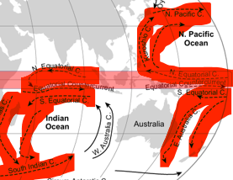





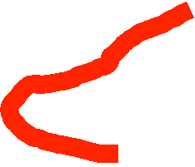





Circle your answers:
Circle your answer:
Q3: Most of the WARM currents are located near the…… EQUATOR POLES
Q4: Most WARM currents flow ____________ the Equator.
TOWARDS AWAY FROM

Slide 12
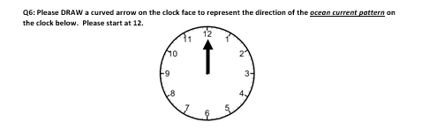
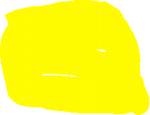
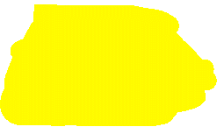
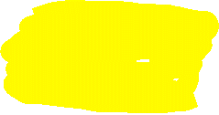
Q5: Which direction pattern do the Ocean Currents flow (TURN) in the NORTHERN HEMISPHERE?
CLOCKWISE COUNTERCLOCKWISE

Slide 13
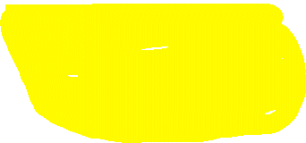
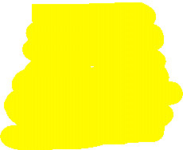
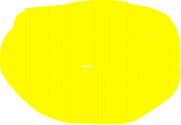
Q6: Which direction pattern do the Ocean Currents flow (TURN) in the SOUTHERN HEMISPHERE?
CLOCKWISE COUNTERCLOCKWISE

Slide 14
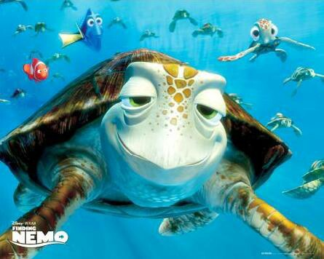
PART 2: IDENTIFICATION of
OCEAN CURRENTS

Slide 15
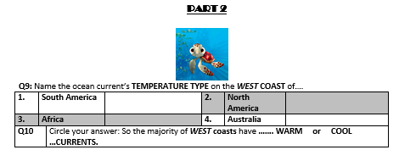
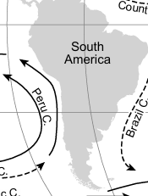
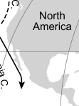
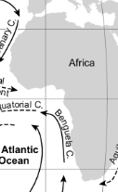
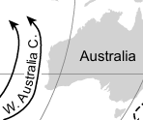
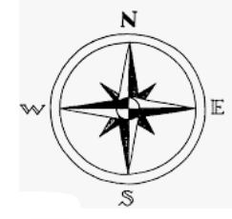

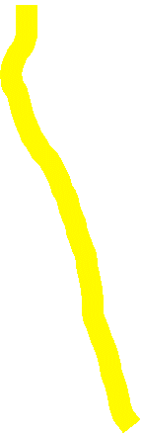






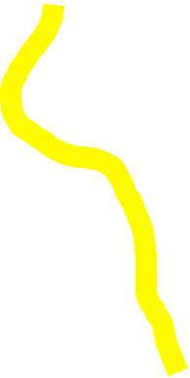

Q7: Name the ocean current’s main TEMPERATURE TYPE on the WEST COAST of…
COOL
COOL
COOL
COOL
COOL
Q8: In summary, the main TEMPERATURE TYPE of all WEST COASTS is _________

Slide 16
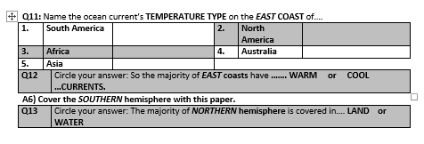
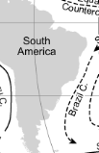
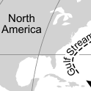
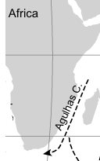
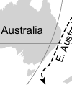
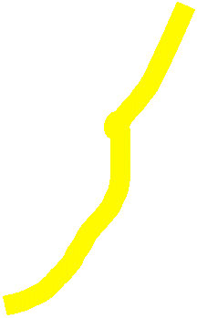
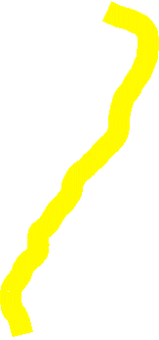







Q9: Name the ocean current’s main TEMPERATURE TYPE on the EAST COAST of…
WARM
WARM
WARM
WARM
WARM
Q10: In summary, the main TEMPERATURE TYPE of all EAST COASTS is ________

Slide 17


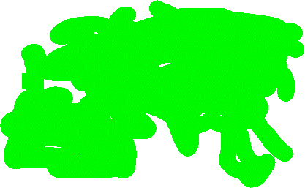

COVER the SOUTHERN hemisphere with this paper
CIRCLE your answer
Q11: Most of the NORTHERN hemisphere is covered in…
LAND WATER

Slide 18
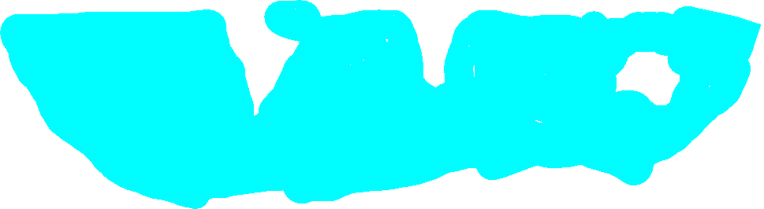
COVER the NORTHERN hemisphere with this paper
CIRCLE your answer
Q12: Most of the SOUTHERN hemisphere is covered in…
LAND WATER

Slide 19




Q13: What is the NAME of the OCEAN near the SOUTH pole?
Q14. What is the NAME of the OCEAN CURRENT located there?
Q15. What is the TEMPERATURE of this ocean current?
SOUTHERN OCEAN
Antarctic Subpolar Current
COLD

Slide 20

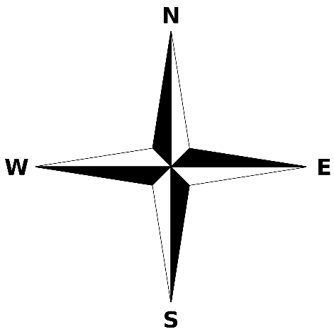
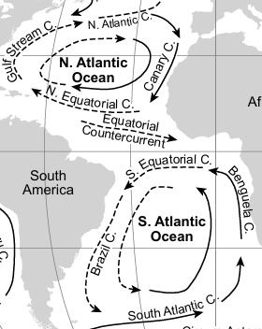


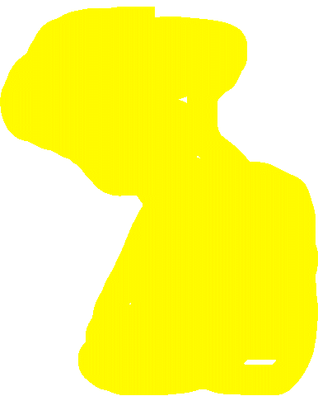
Using a YELLOW crayon/highlighter, COLOR the ENTIRE ATLANTIC OCEAN.
Q16: Which SIDE of the ATLANTIC OCEAN has the most COLD currents?
Q17. Which SIDE of the ATLANTIC OCEAN has the most WARM currents?
EAST
WEST

Slide 21




Q18: Which CURRENT brings hurricanes from N.W. Africa to North America?
Q19. Which CURRENTS bring WARM water from USA to Europe?
Q20. Why do you think the WEST coast of USA does not typically experience hurricanes?
North Equatorial Current
Gulf Stream & North Atlantic C
The California Current located there is COLD & hurricanes need WARM ocean water.

Slide 22
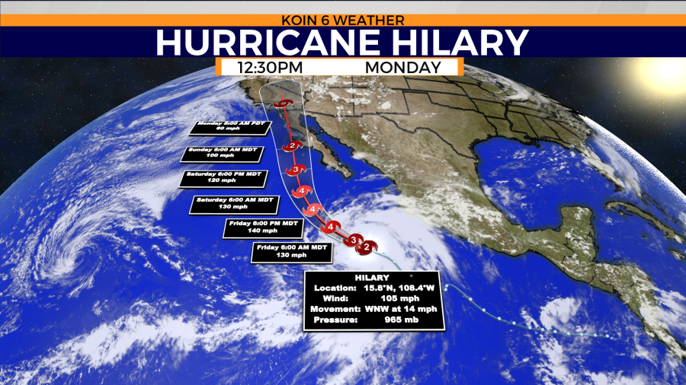
Rare West Coast Hurricane from August 2023. Hurricane Hilary could be Southern California’s first tropical storm since 1939 (youtube.com) 2:20 mins

Slide 23
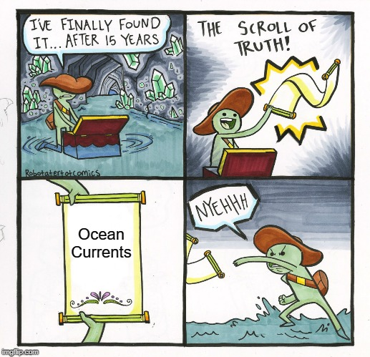
PART 3: REGENTS PRACTICE

Slide 24
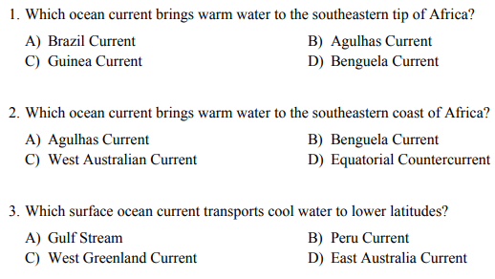

Slide 25
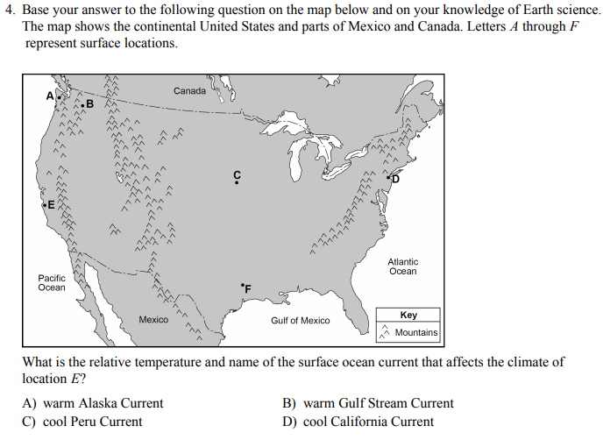

Slide 26

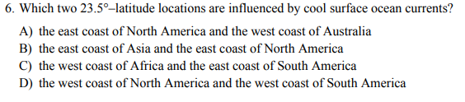

Slide 27
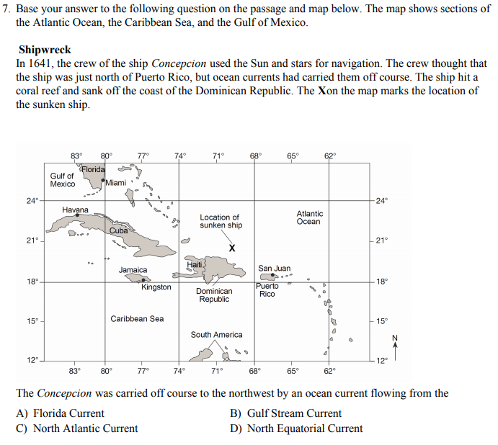

Slide 28
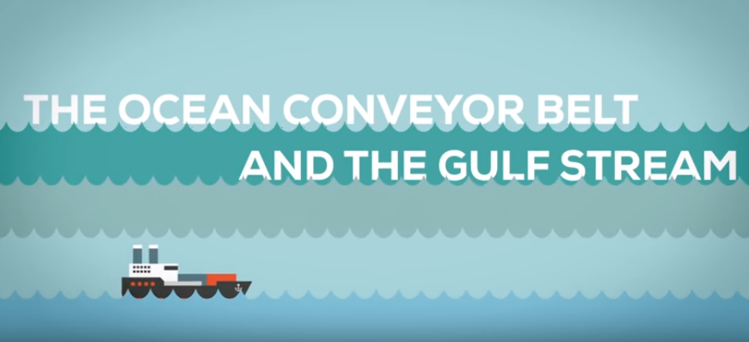
https://www.youtube.com/watch?v=UuGrBhK2c7U 5:04 min

